Slide 1

The Big 5 Leadership Principles that Grow Profits
A Quick Overview

Slide 2



Today We‘ll Cover
why principles matter in leadership
the big 5 leadership principles
prompts for applying each principle
Notes:
A broad topic in just an hour.
Here’s how we’ll do it.
Handout – (pass it out) – to get the most out of this session, write in the principles and make notes about how you can apply them in your work.
Let’s make this time together useful for you.

Slide 3
Why principles matter.
A Tale of Two Bridges: An Analogy
Notes:
Leadership training. (who’s taken part before?)
Most leadership training talks about scary compliance, managerial tactics, leadership styles, and other fluffy stuff.
These are fine topics, but not the most important when it comes to growing a healthy, profitable business.
When it comes to growing a business, principles matter.
Let’s use the analogy of building a bridge for us to drive our family over in a car to understand why principles are important.
PICTURE IN YOUR MIND A BRIDGE. ONE THAT YOU TRUST THE SAFETY OF YOUR FAMILY CROSSING ON. GOT IT?

Slide 4
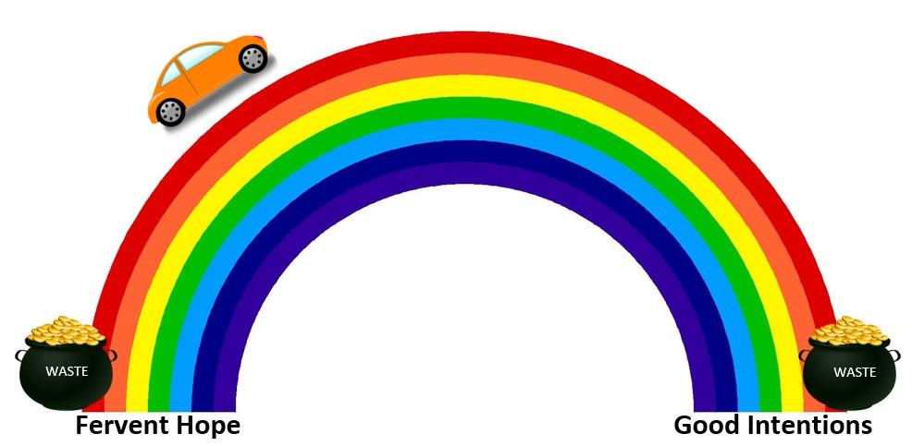
Why principles matter.
A Tale of Two Bridges: An Analogy
Notes:
Here’s one bridge. It’s pretty. Do you trust it to sustain the weight of your car?

Slide 5
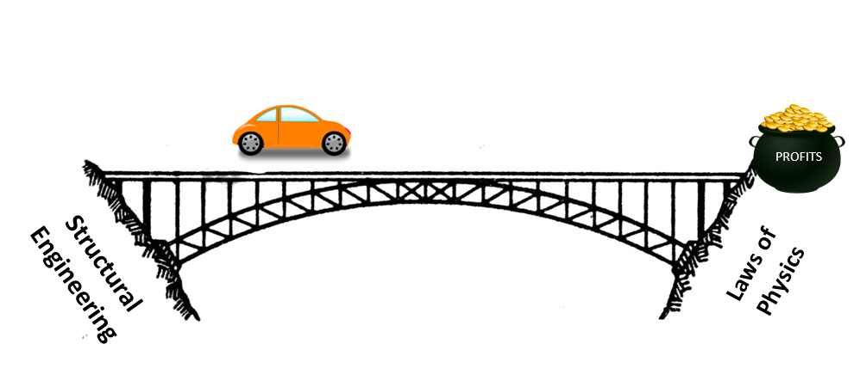
Why principles matter.
A Tale of Two Bridges: An Analogy
PRINCIPLES
Notes:
Here’s another bridge founded on the principles of engineering and laws of physics.

Slide 6
Which one do you want to drive on?
This relates to leadership how?
Notes:
Which one do you want to drive on?
Why?
LEADERSHIP, DONE WELL, IS ALSO BUILT ON PRINCIPLES.

Slide 7
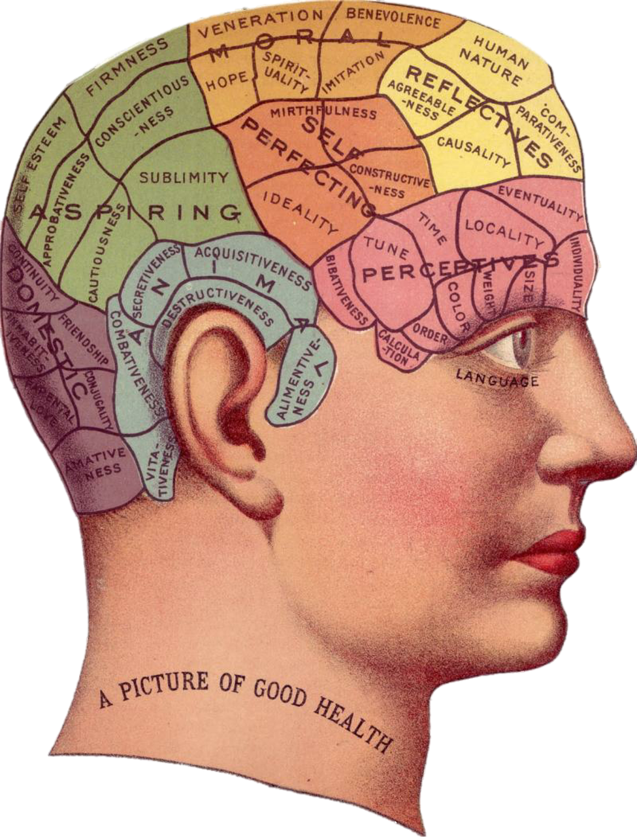
are based on the science of human nature
Principles in leadership…
Notes:
Just like there are principles of structural engineering and physics that allow you to build a bridge you trust with your family’s life, there are principles of leadership that you can trust with the health of your business.
These are principles based on what careful scientific observation tell us about how people think, work, and behave.
This is often different from how we THINK or WISH or HOPE people OUGHT to think, work, and behave.
LEADERSHIP PRINCIPLES ARE BASED ON THE SCIENCE OF HUMAN NATURE.

Slide 8

How leadership principles grow profits.
Attract, keep, & grow high caliber talent.
Cost savings from reduced hardship turnover.
Better strategy development and execution.
Notes:
OK, I get it. Principles are good.
BUT HOW DO LEADERSHIP PRINCIPLES GROW PROFITS?
Using these principles, you create a healthy culture that appeals to the best talent you can get. Then they want to stay. And they also continually develop their ability to bring value to the business.
You keep the best people instead of lose them.
When you apply principles, you do a way, way better job of getting right people in the right seats and getting them what they need to do the necessary work. This translates into GREAT STRATEGY EXECUTION.

Slide 9
The Big 5
Leadership Principles
Notes:
We’ll go over each of the Big 5 in some detail.

Slide 10
People are wired to work and to create at their full capacity and in accordance with their personal drives and preferences.
Principle 1
Notes:
People are satisfied and fulfilled when they are able to work and create. Being prevented from contributing to the social structure is depressing. Work doesn’t need to be coerced. Some kinds of work, maybe. Or work that is inherently the wrong type for someone, sure. But we are all built to work.

Slide 11
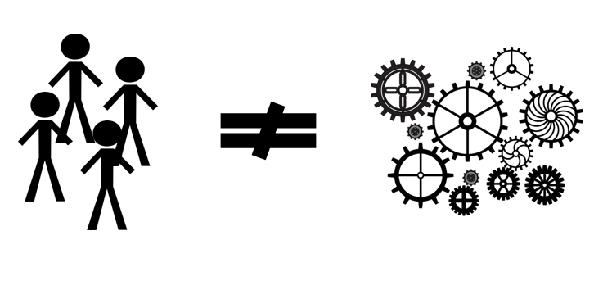
Work is creativity and judgment, not algorithmic.

Slide 12


On Carrots and Sticks.
Can the work itself be the carrot?
Or is it always the stick?
Notes:
The more the nature of work is matched to the capability, talents, and interests of the individual, the more it is inherently motivating. The more the work IS the carrot.

Slide 13
  The better the match between the person and the requirements of the role, the better for the business and the person.
Principle 2
Notes:
Which brings us to principle 2.

Slide 14
Matching Person to Role
How does this change your work?
industry knowledge, technical skills, managerial abilities
time horizon, ambiguity, problem-solving scope, strategic vs tactical
knowledge skills & experiences
(KSEs)
problem-solving capability
sociability, analytical orientation, openness, conflict patterns
travel requirements, culture values alignment, work schedule
talents & preferences
required behaviors
Notes:
I want to show you the four elements of matching person to role.
Don’t have time to go into detail on each one, just get a familiarity.
Punchline: All these things matter for matching the person to the work.
How does this change your work? How can you apply this in your role?

Slide 15
  To be a manager is to be accountable for the outputs of other people.
Principle 3
Notes:
THAT’S THE DEFINITION OF WHAT A MANAGER IS.
Reactions to this? Makes sense? Doesn’t make sense?
Discussion / Q&A.
Let’s try on this idea and see how it works and changes how we make sense of our roles as leaders.

Slide 16
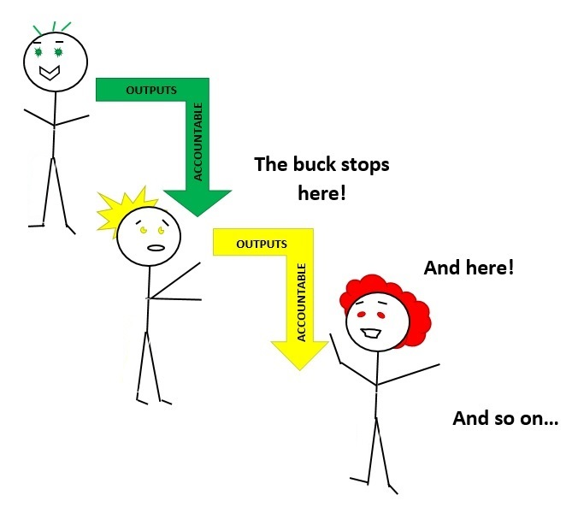
The Accountability Cascade
EMPLOYEE
MANAGER
DIRECTOR
Notes:
Why this principle DOESN’T say– that you’re accountable for everyone else except yourself. A manager is accountable for the performance is his/her immediate team. A manager has the authority to get right people in right seats, enable necessary resources, help set goals, and remove obstacles to those goals.
Explain diagram.
What is the job of the employee in this case?
To perform his/her assigned responsibilities to the best of his/her abilities.
(prompt to write down how to apply this)

Slide 17
  People want managers who can add context and value to their work.
Principle 4
Notes:
When we get stuck on a problem at work– we really appreciate having someone who can help us get unstuck. Ideally, that person is our immediate supervisor. If our supervisor isn’t adding helpful context and value to us in our work, that can be frustrating.
There’s two main ways this can go wrong.

Slide 18
Common Symptoms:
Manager-Employee Capability Mis-match
Employee feels micro-managed.
Employee lacks context for important decisions.
Manager feels like the employee is trying to do the manager’s job instead of focusing on their own.
Communication filters through organization but without adequate context.
Manager feels pulled into the weeds.
Employee doesn’t get degree of clarity they need and feels left on their own.
Communication gaps emerge even though manager really is communicating.
MANAGER
GAP TOO BIG
MANAGER
NO GAP
EMPLOYEE
EMPLOYEE
Notes:
Think about situations in your work-life that illustrate both conditions. Neither option is good. Neither option gives us the context and value we’re hungry for in our work.

Slide 19
  Accountability must equal authority for any role or you get dysfunction.
Principle 5
Notes:
Accountability is responsibility for outcomes of something. Authority means the ability to make decisions that impact those outcomes.

Slide 20
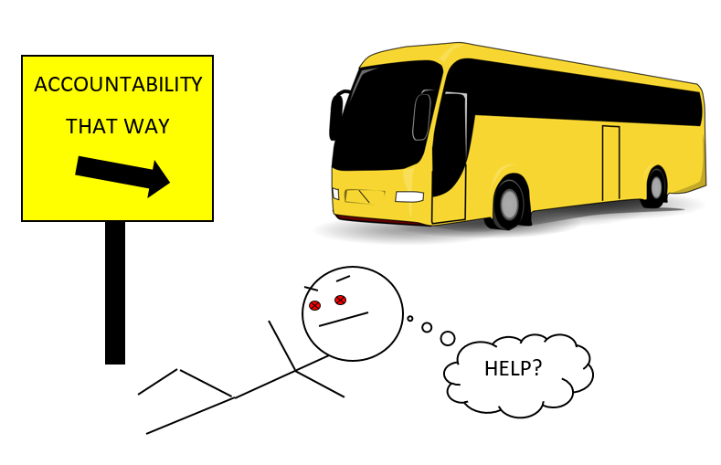
when accountability authority
Notes:
When accountability and authority are out of sync, it can feel like we’re getting run over by a bus.
Think about the roles of their team members and whether there room to get accountability and authority better synced.

Slide 21
Recap: The Big 5 Leadership Principles
Principle 1
People are wired to work and create at their full capacity and in accordance with their personal drives and preferences.
Principle 2
The better the match between the person and the requirements of the role, the better for the business and the person.
Principle 3
To be a manager is to be accountable for the outputs of other people.
Principle 4
People want managers who can add context and value to their work.
Principle 5
Accountability must equal authority for any role or you get dysfunction.
Notes:
For each principle, describe one change you can make in your work today.

